Slide 1
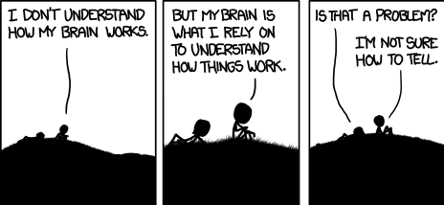
An Automated Images-to-Graphs Pipeline for High Resolution Connectomics
Will Gray Roncal
February 26, 2015

Slide 2
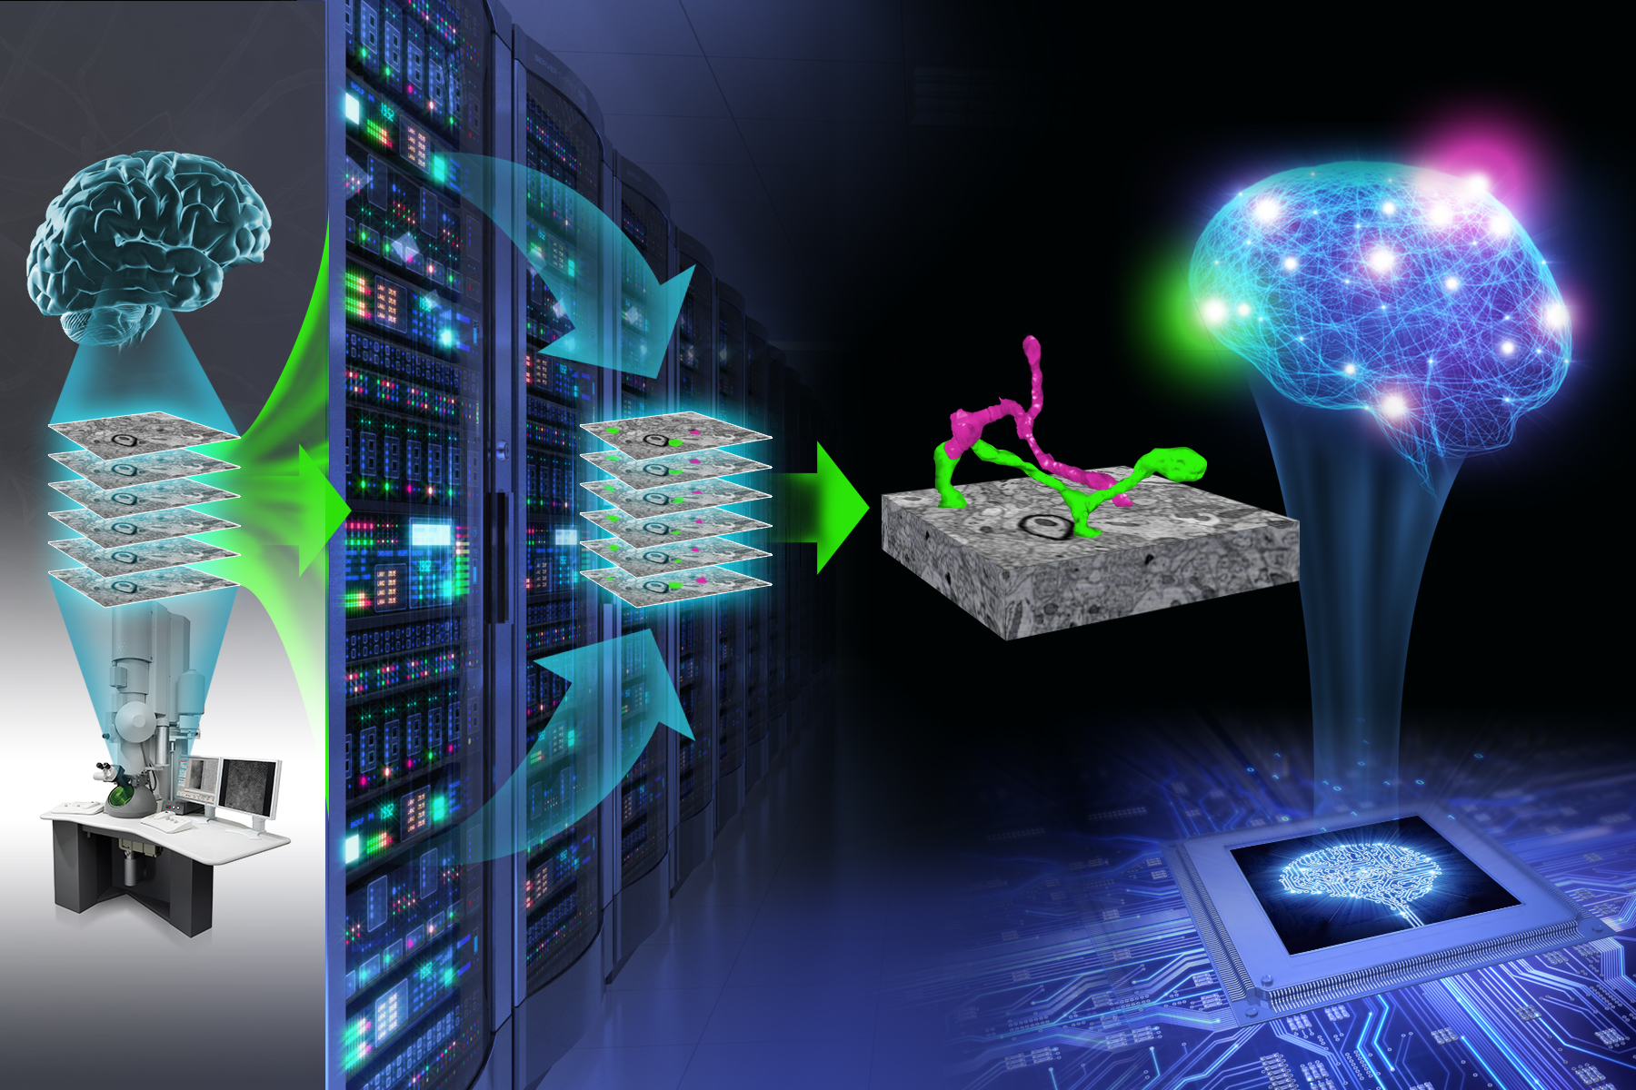
Mapping the Brain!

Slide 3
Opportunity
Technological advances have produced massive volumes of brain tissue for the first time, containing neuronal circuits
Manual tracing is untractable; existing algorithms solve only sub-portions of the problem
This paper presents the first fully-automated framework to generate and assess graphs
Provides a reference pipeline and tools to improve and use for science

Slide 4
Challenge
Running data at scale is non-obvious and existing solutions are often not reproducible
Many of the problems we face require an overall systems view to solve
Researchers have made great advances, but typically focus on one aspect of the problem
Errors in graph connectivity are not distributed uniformly

Slide 5
Action
We built an automated images-to-graphs pipeline
Several modular components to estimate:
Neurons (nodes)
Synapses (edges)
Combine everything together into a graph

Slide 6
Action (2 of 2): Line Graphs
We built a novel way to compute overall graph error using computer vision methods
Relies on comparing two graphs directly
Uses line graph to make graph matching easy (matching neuronal graphs is hard!)

Slide 7
Key Results
Pipeline demonstrated to create 1300 reference graphs (each cell is one graph)
Best operating point is not at the point where synapse error metric and segmentation error metric are lowest

Slide 8
Back of Napkin Compute Required for one terabyte
Existing methods
GPU Hours: 200,000 (membrane segmentation)
CPU Core Hours: 15,000 (neuron/synapse/merging)
With “easy” optimizations
GPU Hours: 20,000 (membrane segmentation)
CPU Core Hours: 5,000 (neuron/synapse/merging)
EC2 cost (Feb 2015)
1 GPU Hour: 0.65
1 CPU Core: 0.05 (EC2)
Existing: $130,000/TB or $130,000,000/PB
Optimized: $13,250/TB or $13,250,000/PB
Davi’s data (~12TB): Roughly $40k (optimized, multi-scale processing) – we can do better

Slide 9
Resolution
Paper presents a new framing of the connectomics problem
Tools are open source and help other researchers solve problems and think about end-to-end connectomics
Error metric gives a tool to assess results (rather than relying on intermediate metrics)
Things to consider
Line graphs are one possible error metric – maybe others are better?
The graphs that are produced are still very errorful and may not be ready for analysis yet

Slide 10
Future
Deploy pipeline on Amazon cluster
Incorporate additional tools from the community (synapse detector, Gala)
Normalize metric to increase interpretability
Publish!
Scale and solve problems as they appear
Spines to shafts
Merge boundaries
High level constraints

Slide 11
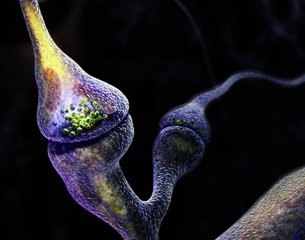
Acknowledgments
Project to host, process, and analyze connectomes (at different scales – nm to mm) and the associated data, code, and graphs
www.openconnectomeproject.org
This work is collaborative with many people (partial list):
Omair Akmal
Alex Baden
Daniel Berger
Davi Bock
Randal Burns
Mark Chevillet
Mitya Chklovskii
Jose Conchello
Marysol Encarnacion
Kel Guerin
Greg Hager
Ray Jones
Bobby Kasthuri
Verena Kaynig
Greg Kiar
Dean Kleissas
Seymour Knowles-Barley
Travis Latchman
Colin Lea
Wei-Chung Allen Lee
Kunal Lillaney
Jeff Lichtman
Priya Manavalan
Hanspeter Pfister
Carey Priebe
Purnima Rajan
Ayushi Sinha
Stephen Smith
Daniel Sussman
Jacob Vogelstein
Joshua Vogelstein
Alyssa Wilson
Da Zheng

